Slide 1
Factorising with a common term
Week 2 / lesson 3

Slide 2
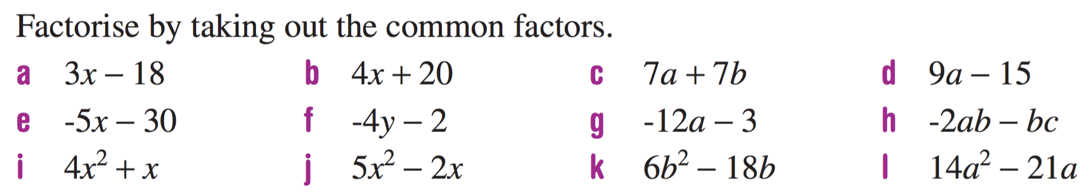
Mental set
Notes:
hook

Slide 3
Lesson objective
By the end of this lesson you will be able to;
- Identify common terms in binomials, and use these to factorise expressions.
Notes:
Lesson

Slide 4
24
7
30
Date
Common terms in binomials
EQ – How can we use common terms in binomials to solve problems?
A binomial is an expression with two terms.
When and expression has a common term, we can use it to simplify our working.
For example:
7(x+4) + 12(x+4) has a common term of (x+4)
Because this is a common term, both 7 and 12 are being distributed into these.
To solve this, we put the common term first
(x+4), then the two coefficients in a separate set of brackets (7+12), then write it as below;
(x+4)(7+12)
5
Notes:
Lesson objective (EQ)

Slide 5
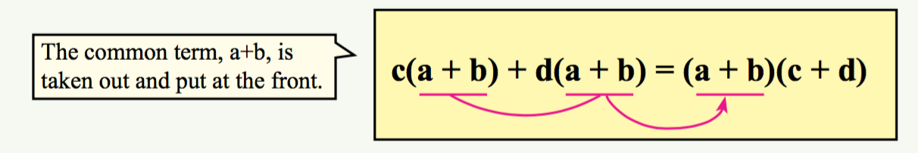
24
7
30
Common terms in binomials
EQ – How can we use common terms in binomials to solve problems?
Why does this work?
Lets look at a more in depth example:
7x(2x+4) + 2y(2x+4) – same as before, common term at the front
(2x+4) then the left overs second (7x+2y), write together;
(2x+4)(7x+2y)
Because of the common term, and that each of the front coefficients multiply the common term, we can simplify as above.
5

Slide 6
24
7
30
Date
Common terms in binomials
EQ – How can we use common terms in binomials to solve problems?
FOIL;
F- First. O- Outside. I-Inside . L-Last
FOIL is another method of distribution often used when we have four terms in two sets of brackets.
7x(2x+4) + 2y(2x+4)
=(2x+4) - Common term and (7x + 2y) – Coefficients
=(2x+4) (7x+2y)
Once they are in the brackets, we can double check our answer.
5
Notes:
Input

Slide 7
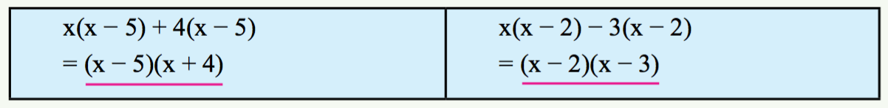
Guided Practice
1:
2(x+3) + y(x+3)
Put common term first – (x+3)(_ _ _)
Fill in the blanks- (x+3)(2 _ y)
Finally, the second operator is taken from in front of the 3, leaving us with the finished expression; (x+3)(2+y)
2:
a(x+5) - 3(x+5) – identify common term – (x+5)
Put common term first – (x+5)(_ _ _)
Fill in the blanks- (x+5)(a _ 3)
Finally, the second operator is taken from in front of the 3, leaving us with the finished expression; (x+5)(a-3)
Notes:
Guided practice

Slide 8
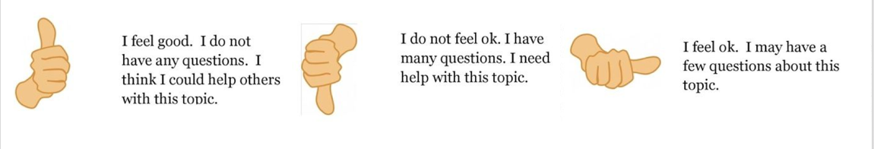
Check for understanding
Notes:
Check for understanding

Slide 9
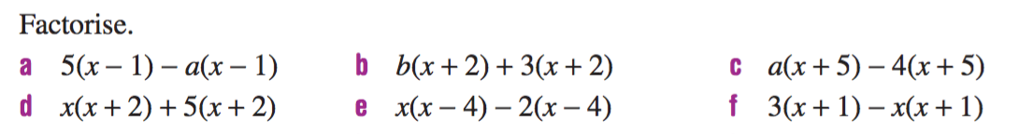
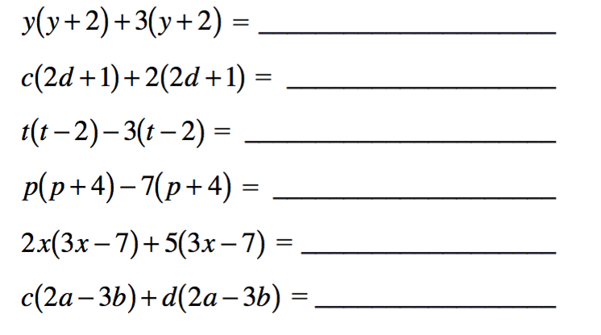
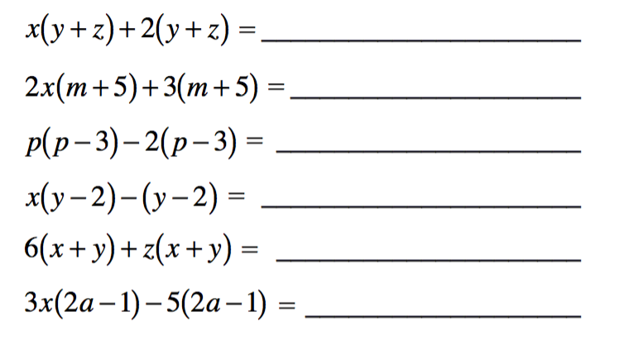
Activity
Factorise by removing the common term.
Notes:
Independent practice

